Slide 1
An adaptation of hybrid binary optimization algorithms for medical image feature selection in neural network for classification of breast cancer
JUSTICE TETTEH(10981523)
EMMANUELLA POKUAA DANSO(10980151)

Slide 2
RECAP (Introduction)
Medical images often present high-dimensional datasets, posing challenges in efficient analysis and feature selection. Traditionally, these challenges have been addressed with standard methods that may not fully optimize classification performance. This project introduces four variants of hybridized binary optimization algorithms which enhance feature selection for medical image datasets by leveraging BEOSA as a base. These algorithms incorporate a novel nested transformation function, creating variants that optimize binary search spaces while preserving the relevance of real-world features. Through experiments on digital mammography datasets, the proposed methods demonstrate superior performance in improving classification accuracy over traditional techniques.

Slide 3
Recap( Problem statement)
High-dimensional datasets, particularly in medical image analysis, present significant challenges in machine learning and classification tasks. These challenges include increased computational complexity, overfitting, and reduced model interpretability. Specifically, when working with breast cancer detection from medical imaging data (such as mammograms or histopathology images), the number of features can be vast, leading to a risk of decreased classification accuracy and model performance.
However, relying solely on conventional feature selection methods may not provide optimal solutions for complex medical imaging datasets.

Slide 4
Recap(Proposed Solution)
Adaptation of hybrid binary optimization algorithms for medical image feature selection in neural network, particularly focusing on breast cancer. (HBEOSA-DMO, HBEOSA-PSO, HBEOSA-DMO-NT and HBEOSA-PSO-NT)
These are obtained from the hybridization of BEOSA as the base algorithm with BDMO and BPSO, to obtain HBEOSA-DMO and HBEOSA-PSO. The algorithms are enhanced by nested transformation function, leading to the four variants (HBEOSA-DMO,HBEOSA-PSO,HBEOSA-DMO-NT and HBEOSA-PSO-NT) proposed.

Slide 5
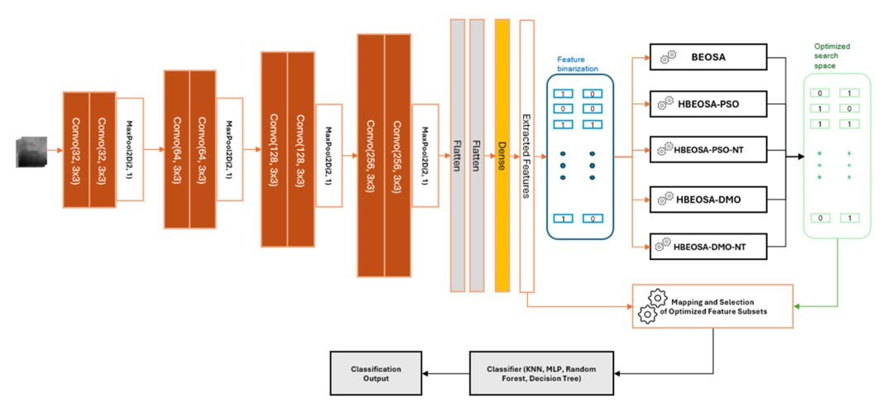
Recap (Flow of Proposed Solution)

Slide 6
Demonstration Of Details involved in the Binary hybridisation of BEOSA with BDMO and BPSO Process of the various algorithms.
This presentation explains how the hybrid algorithms were created.
First, we look at the structure and behavior of the individual algorithms — BDMO and BPSO.
Next, we show exactly how they were combined with the base algorithm, BEOSA.
Finally, we walk through how the full hybrid models operate from start to finish.

Slide 7
DMOSA
The Binary Dwarf Mongoose Optimization (BDMO) algorithm is a recent addition to the family of binary optimization techniques, designed to improve feature selection and classification tasks. Inspired by the behavioral patterns and social structures of dwarf mongooses, BDMO effectively navigates the binary search space, enabling efficient identification of optimal feature subsets in high-dimensional datasets.

Slide 8
Key Features of BDMO and how they affect the Hybridization Process
Population-Based Approach:
BDMO utilizes a population of candidate solutions, each represented as a binary vector. This representation enables the algorithm to efficiently explore the search space and focus on the most promising regions during optimization.
Social Interaction:
Reflecting the cooperative behavior of dwarf mongooses, BDMO incorporates social dynamics to guide individuals in the population toward better solutions through collaboration. Members share information about their fitness, which influences the decisions and movements of others.
Enhanced Exploration and Exploitation:
BDMO effectively balances exploration (searching new areas of the search space) and exploitation (refining the best current solutions). This balance is crucial to avoid premature convergence and local optima, which are common challenges in optimization algorithms.

Slide 9
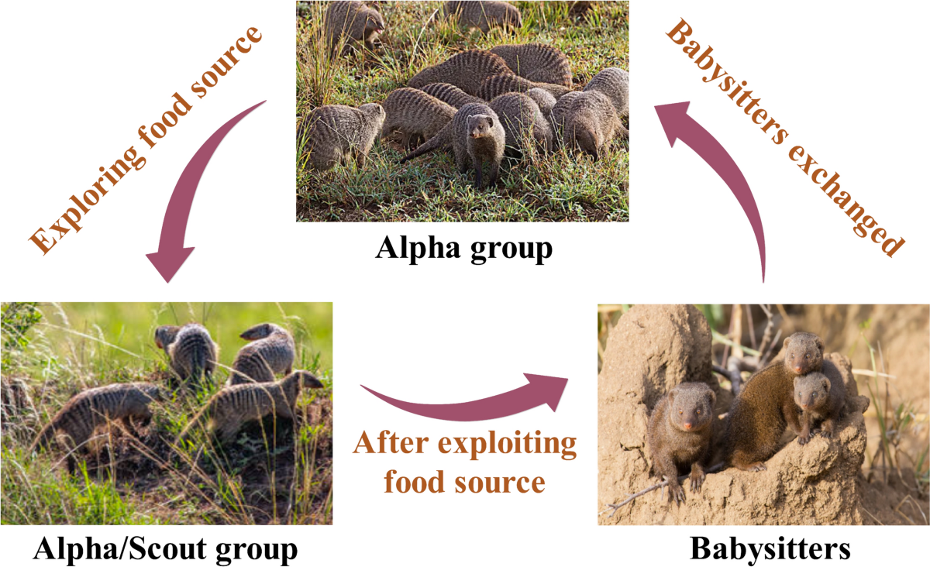
Key Features of BDMO and how they affect the Hybridization Process

Slide 10
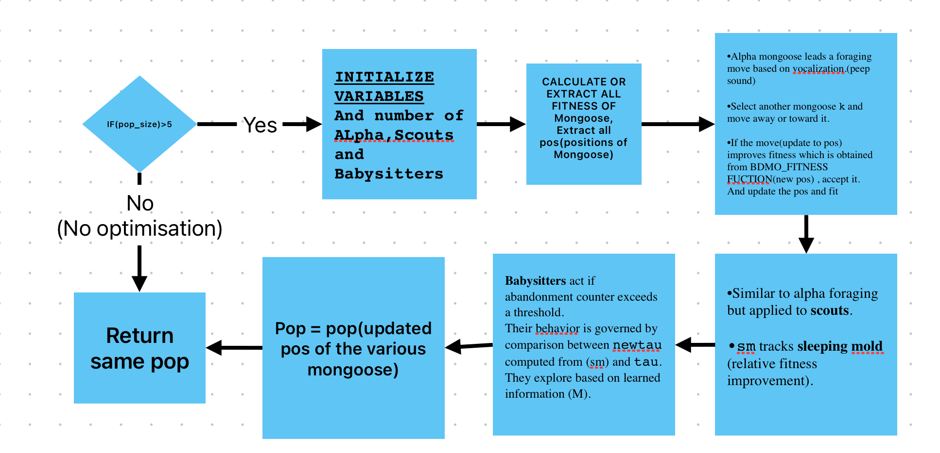
Flow Chart of BDMO

Slide 11
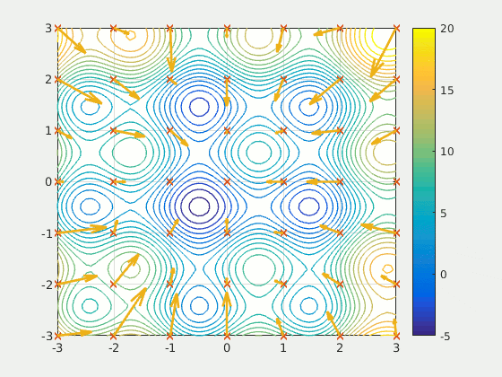
Overview of Particle Swarm Optimization (PSO)
PSO is a population-based optimization method inspired by social behaviors.
Each candidate solution (particle) adjusts its position based on its personal best and the overall global best.
It does not require differentiability, making it suitable for various optimization problems.

Slide 12
PSO
BPSO adapts the continuous PSO to binary decision spaces, representing solutions as binary strings.
Updates are performed using velocity equations and a sigmoid transfer function that converts velocities into binary decisions.
This method enables systematic convergence toward promising feature subsets

Slide 13
HOW PSO OR BDMO IS INTEGRATED INTO BEOSA
The hybridization process in BEOSA with BPSO or BDMO primarily occurs during the generation of a susceptible population. A given infected candidate (representing an Ebola virus carrier) can infect others. This hybridization focuses on updating the features (positions) and fitness values of individuals who have been infected by either:
a selected infected candidate (exploration), or
the entire population, once the number of individuals to be infected has been infected (exploitation).
The rate of infection—determined by the neighborhood threshold of a candidate—dictates whether exploration or exploitation should occur. It also informs the type of nested transform function to use: either s(v) or v(s) in algorithms that use the NT.
Features extracted from medical images and transformed into their binary state are treated as:
Patient features in BEOSA
Position vectors of the Dwarf Mongoose in BDMO, and
Position vectors of particles in PSO.

Slide 14
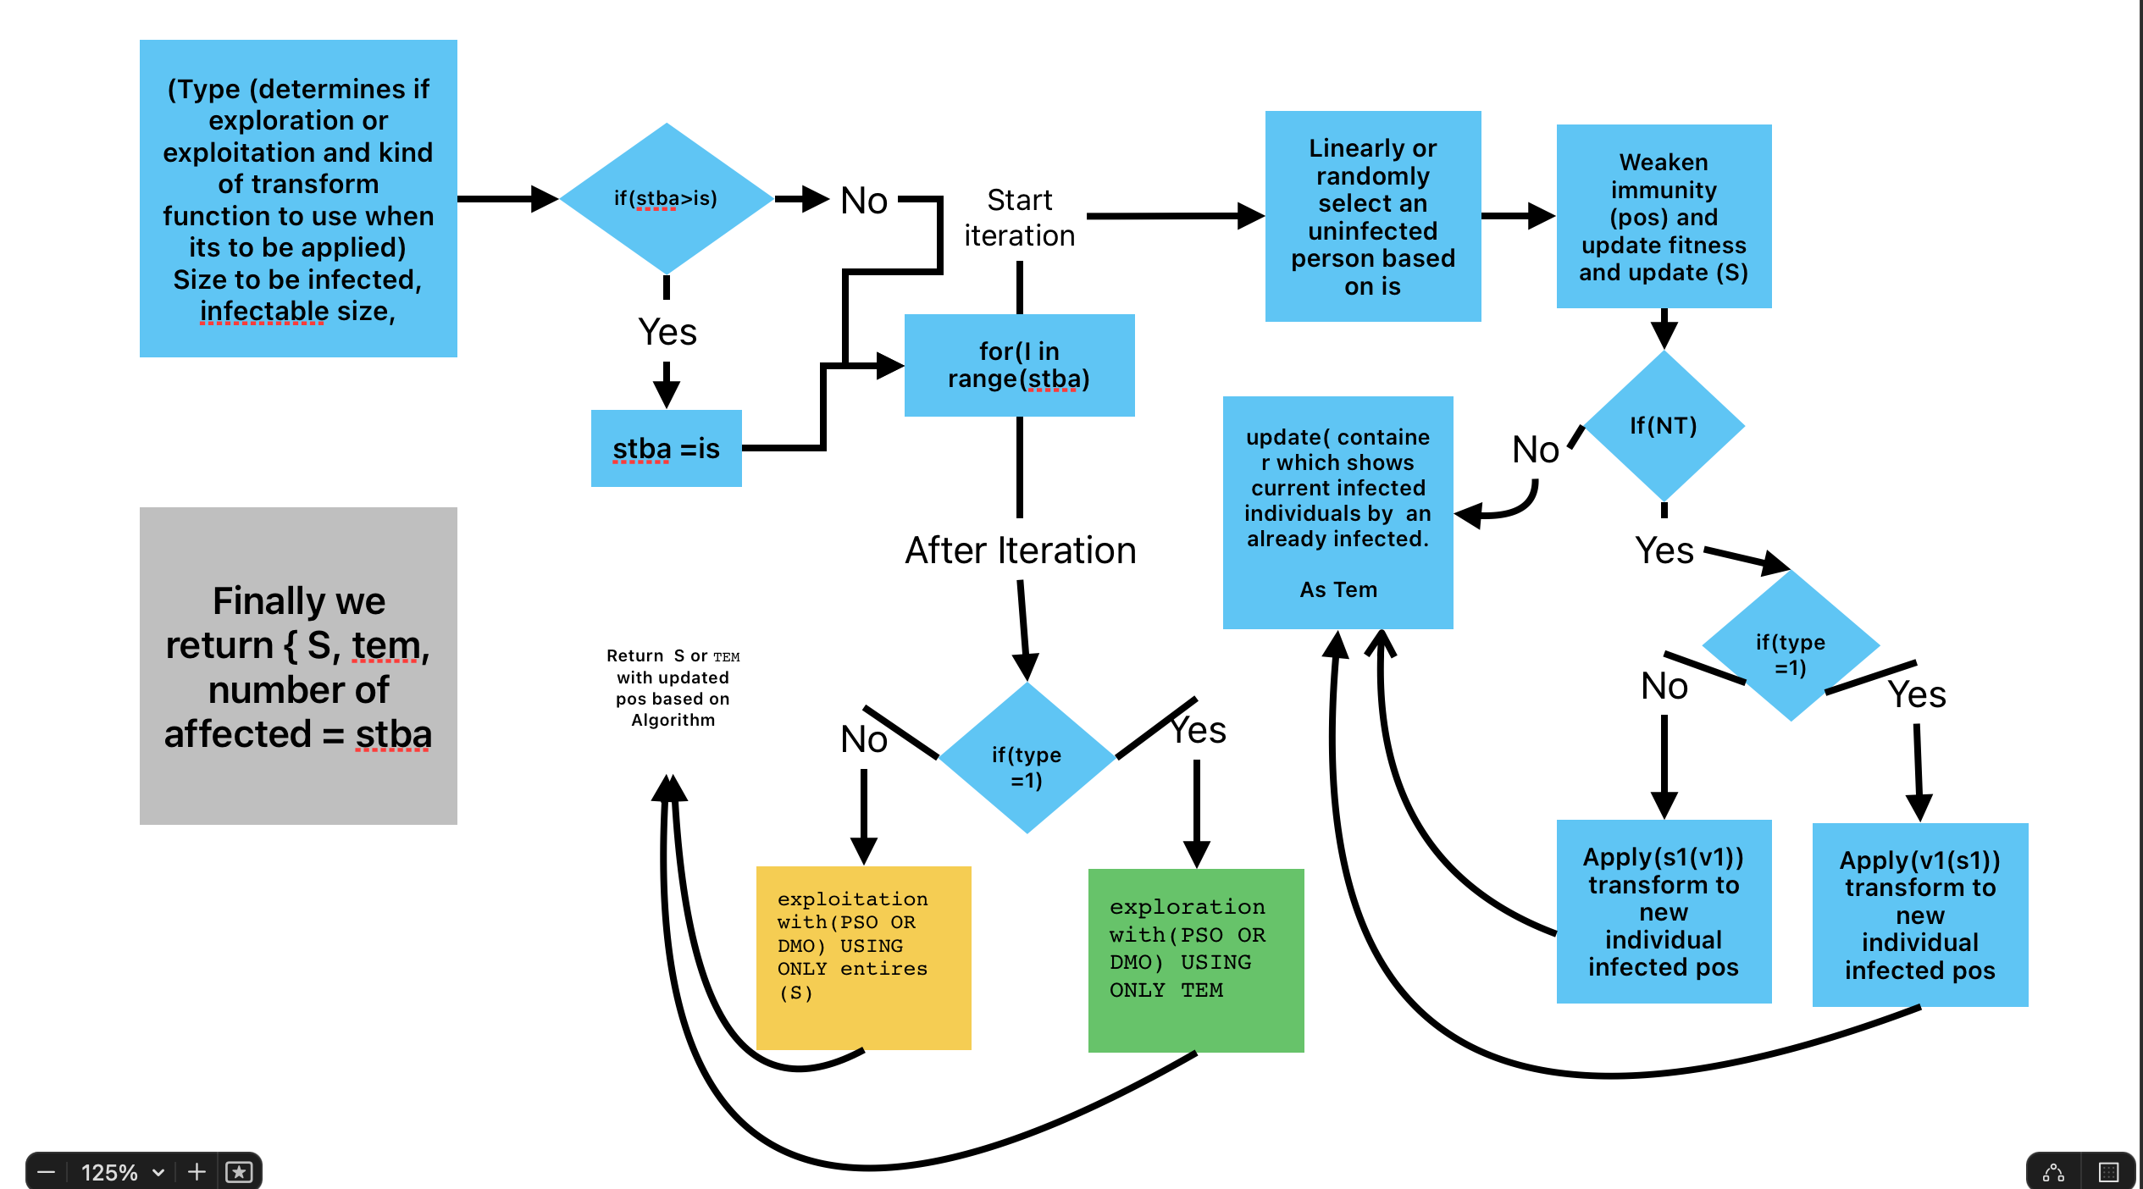
Flow Chart on How Each Infected Individual affects its population

Slide 15
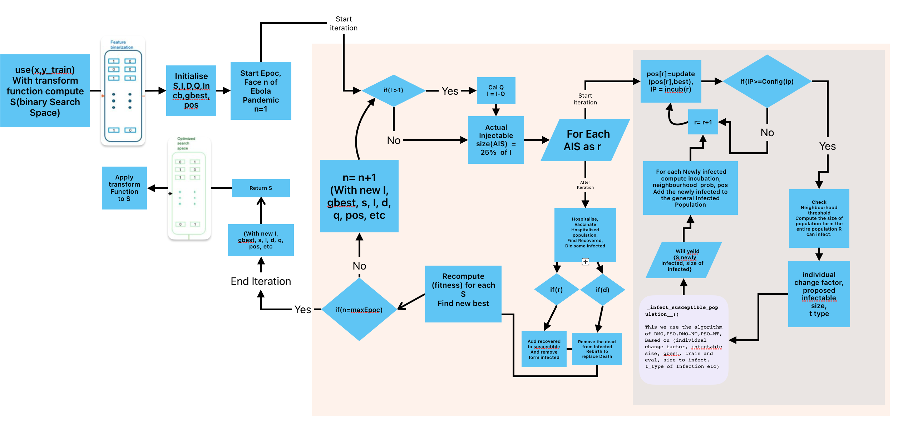
Overall Flow chat of HBESOA-DMO OR HBESOA-PSO with or without NT

Slide 16
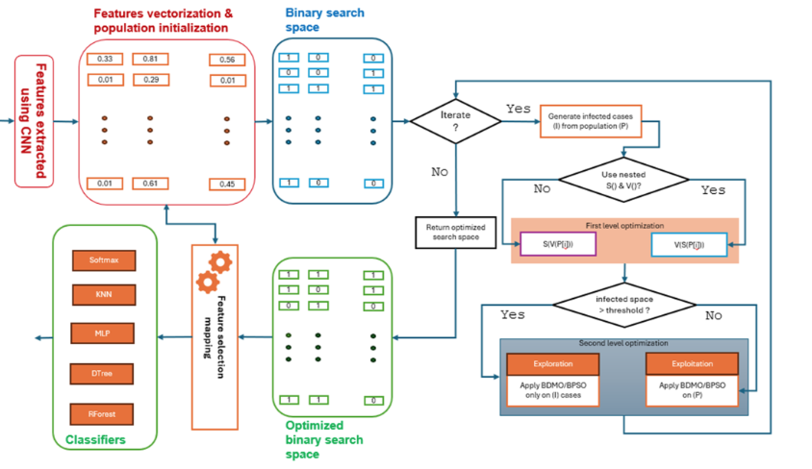
Summary Flow Chart

Slide 17
QUESTIONS OR SUGGESTIONS

